Slide 1
Use the IF logic function

Slide 2

Camera Expectations

Slide 3



Before we start… Please have your camera switched on.
Camera Expectations
This is a mandatory requirement for the duration of the course.
You are studying a regulated qualification, your tutor needs to see that it is the right person participating throughout the course.
Our job is to prepare you for work in an age where in almost any job there is likely to be at least some aspect of remote engagement with your employer.
Online learning is to be treated the same way as a classroom learning, you must be physically visible to interact with your tutor and other learners in order to create an engaging group dynamic.

Slide 4


Background filters
If you do not wish to have your camera displaying your personal environment, Microsoft Teams has a solution to this problem…
Step One: Before you join a Teams video call, click the ‘Background Filters’ option.
Step Two: On the right-hand side, you can select any of the stock images.
Step Three: The image you choose will then appear in your background on the video call.
If you need any further support in regards to this requirement, please speak to your tutor directly.

Slide 5
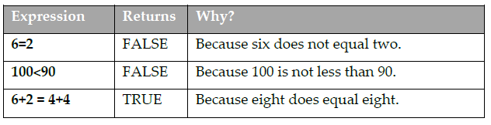
logical tests
The IF function requires a logical test and then performs one action if the test returns TRUE and a different action if the test returns FALSE.
Here are some examples of logical tests:
Notes:
The IF function is one of Excel’s most widely used and useful functions. It is also a function that often confuses people, so I’ll begin this lesson by explaining the concept of the logical test.

Slide 6
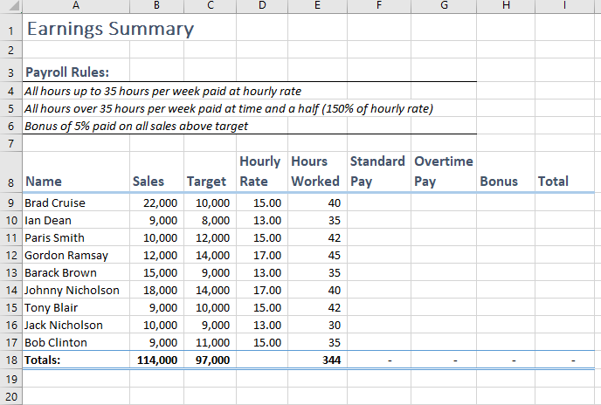
Open Earnings Summary-1 from your sample files folder

Slide 7
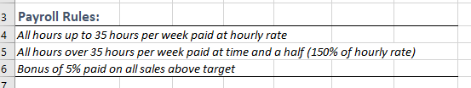
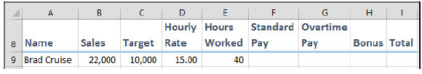
Notice the Payroll Rules section:
Logical tests will be constructed to calculate Standard Pay, Overtime Pay and Bonus:

Slide 8
Use an IF function to calculate standard pay.
In the case of Standard Pay, the logical test will be:
“Did this employee work more than 35 hours this week?”
The formula for the logical test is: E9<=35 (the value in cell E9 is less than or equal to 35).
If this returns TRUE, then standard pay will be:
Hours Worked * Hourly Rate, (E9*D9)
…because the employee worked for 35 hours or less.
If this returns FALSE, then standard pay will be:
35*Hourly Rate (35*D9)
… because the employee worked more than 35 hours (and the first 35 hours of this time will be paid at standard rate).

Slide 9
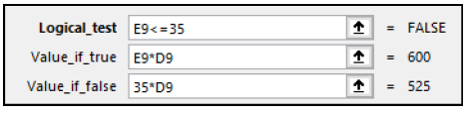
Continued …
1. Click in cell F9.
2. Click: Formulas→Logical→IF.
The Function Arguments dialog appears.
3. Complete the dialog as follows:
4. Click the OK button.
Standard Pay is correctly displayed in cell F9 (525.00).

Slide 10
Use an IF function to calculate overtime pay in cell G9.
Use an IF function to calculate overtime pay in cell G9.
It should now be clear to you why the correct arguments for the IF function, this time, are:
(The Value_if_false argument would have worked in exactly the same way if you had used a value of 150% instead of 1.5 as Excel recognises both as having the same value but different formats).

Slide 11
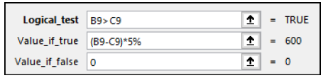
Use the IF function to calculate the bonus in cell H9.
Use the IF function to calculate the bonus in cell H9.
Once again, it should be clear to you why the correct arguments for the IF function this time are:

Slide 12
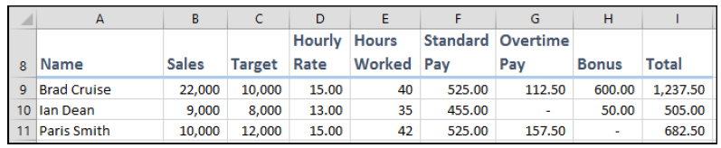
Add a formula to cell I9 to calculate total pay.
Add a formula to cell I9 to calculate total pay.
The correct formula could be either of the following:
=F9+G9+H9
=SUM(F9:H9)
6. AutoFill the formulas in cells F9:I9 to cells F17:I17.
The payroll worksheet is now complete.
Save your work as Earnings Summary-2.
Notes:
Practise by viewing the formulars by going back over them

